Slide 1
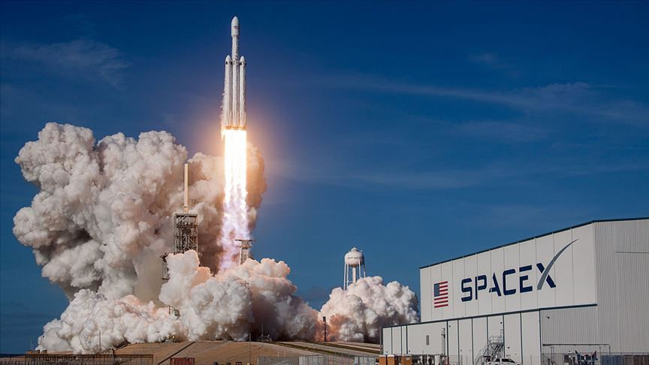







SpaceX Falcon9 first stage Landing Prediction
Erkut Koral
05.12.2022
Reference:
IBM Data Science Professional Certification curriculum, hosted on Coursera.com and CognitiveClass.ai

Slide 2



OUTLINE
Executive Summary
Introduction
Methodology
Results
Visualization – Charts
Dashboard
Discussion
Findings & Implications
Conclusion

Slide 3

EXECUTIVE SUMMARY
Data Collection
Data collection with API
Data collection with Web Scraping
Data Wrangling
Exploratory Data Analysis
EDA with SQL
EDA with Data Visualization
Interactive Visual Analytics with Folium
Features Engineering
Machline Learning Predictions
Summary of all results
Exploratory Data Analysis results
Interactive Analytics with screenshots
Prediction results

Slide 4


INTRODUCTION
Project Background
SpaceX advertises Falcon 9 rocket launches on its website with a cost of 62 million dollars; other providers cost upward of 165 million dollars each, much of the savings is because SpaceX can reuse the first stage. Therefore, if we can determine if the first stage will land, we can determine the cost of a launch. This information can be used if an alternate company wants to bid against SpaceX for a rocket launch.

Slide 5
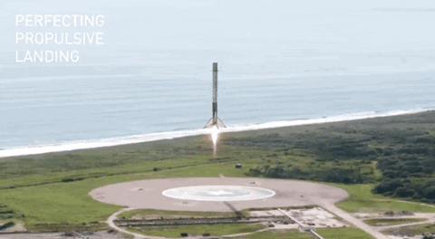
INTRODUCTION
Questions we want to answer:
Will Falcon9’s first stage be land successfully?
What factors affect this landing?
For reaching the notebooks, check out the github icon below of the pages.

Slide 6
Data Collection

Slide 7

METHODOLOGY 1)Data Collection
The data was collected in different methods:
First, we created requests.get() object and took the reponse from API.
Then, we decoded that response and used .json_normalize() to turning it to pandas DataFrame.
After that, we took our features from that DataFrame.
Finally, we cleaned the data, checked for missing values and filled them with mean value of that features.
In addiction, we collected the data with Web Scraping method, using BeautifulSoup.

Slide 8
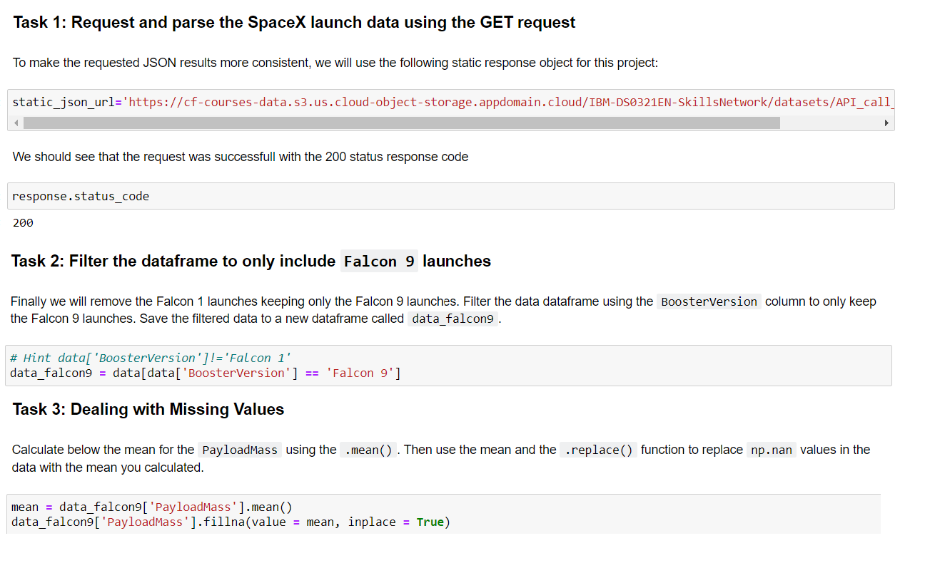
METHODOLOGY 1)Data Collection with API

Slide 9
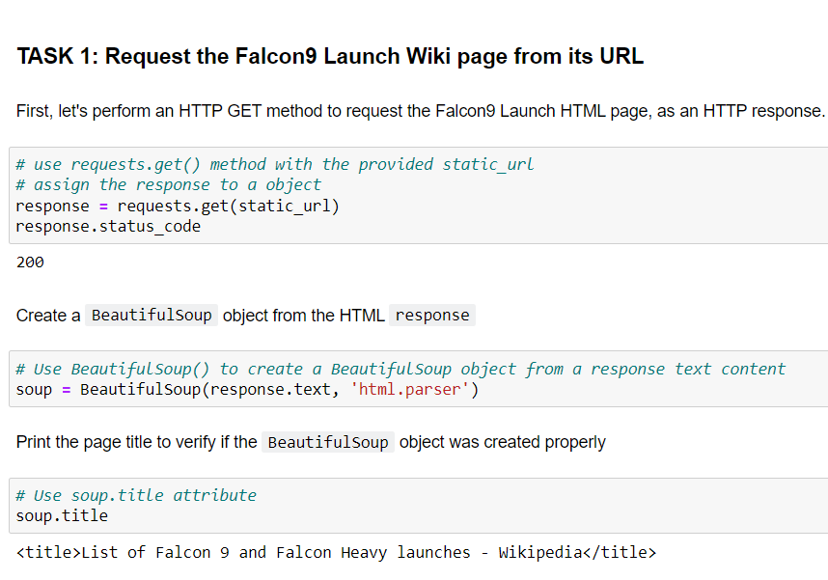
METHODOLOGY 1)Data Collection with Web Scraping
We started with Task1.
We created column names object with its
function for taking column names from Wikipedia.
Created an empty dictionary for taking which
features we want to take.
Put that features in empty dictionary and created
a dataframe from it.

Slide 10
Data Wrangling

Slide 11
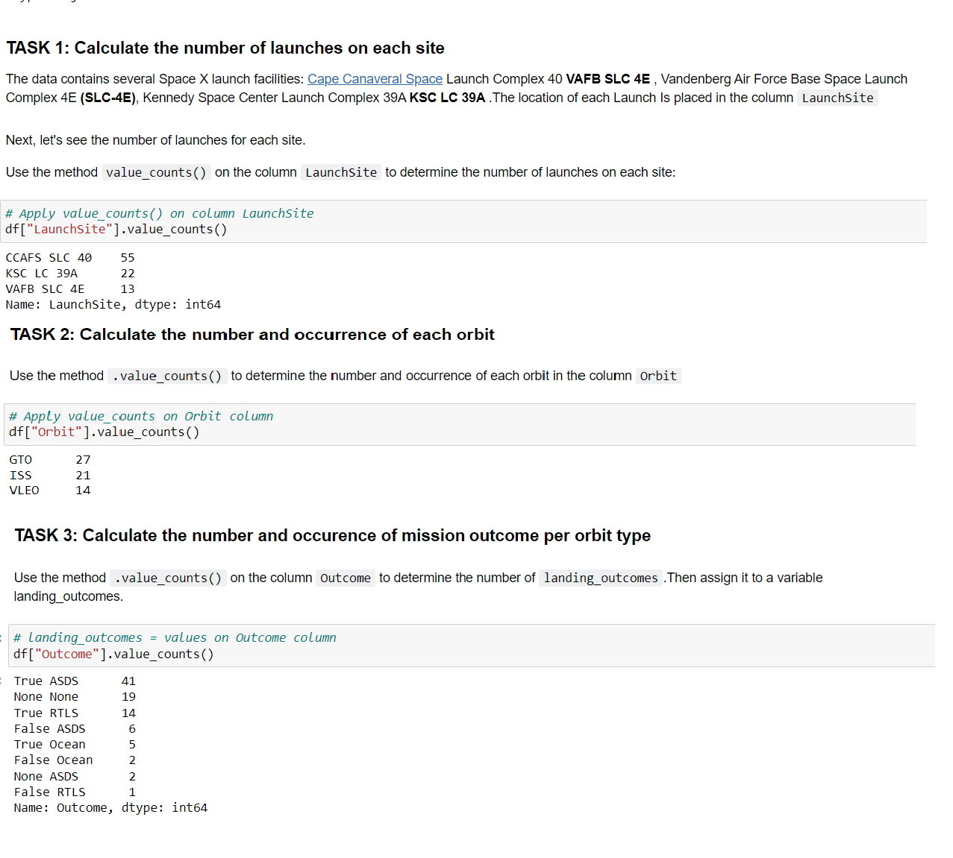
METHODOLOGY 2)Data Wrangling
After, all tasks were done, for taking outcome to
the class column we need to parse them like:
Bad outcomes (did not land)(0)
Other outcomes (land) (1)

Slide 12
Exploratory Data Analysis (EDA)

Slide 13
METHODOLOGY 3)EDA with SQL
We explored data with some questions and applying that questions to SQL.
These questions are:
Display the names of the unique launch sites in the space mission
Display 5 records where launch sites begin with the string 'CCA'
Display the total payload mass carried by boosters launched by NASA (CRS)
Display average payload mass carried by booster version F9 v1.1
List the date when the first successful landing outcome in ground pad was acheived.
List the names of the boosters which have success in drone ship and have payload mass greater than 4000 but less than 6000
List the total number of successful and failure mission outcomes
List the names of the booster_versions which have carried the maximum payload mass. Use a subquery
List the failed landing_outcomes in drone ship, their booster versions, and launch site names for in year 2015
Rank the count of landing outcomes (such as Failure (drone ship) or Success (ground pad)) between the date 2010-06-04 and 2017-03-20, in descending order

Slide 14
METHODOLOGY 3)EDA with Data Visualization
We explored data with data visualization and tried to answer these following questions:
Visualize the relationship between Flight Number and Launch Site
Visualize the relationship between Payload and Launch Site
Visualize the relationship between success rate of each orbit type
Visualize the relationship between Flight Number and Orbit type
Visualize the relationship between Payload and Orbit type
Visualize the launch success yearly trend

Slide 15
METHODOLOGY 4)Interactive Visual Analytics with Folium
The launch success rate may depend on many factors such as payload mass, orbit type, and so on. It may also depend on the location and proximities of a launch site, i.e., the initial position of rocket trajectories. Finding an optimal location for building a launch site certainly involves many factors and hopefully we could discover some of the factors by analyzing the existing launch site locations.
This section contains the following tasks:
Mark all launch sites on a map
Mark the success/failed launches for each site on the map
Calculate the distances between a launch site to its proximities

Slide 16
Features Engineering

Slide 17
METHODOLOGY 5)Features Engineering
When predicting the landing outcome, we need to take the features that will serve this purpose.
So, we dropped Date, BoosterVersion, Outcome, Longitude and Latitude features.
Used get_dummies() function to apply One Hot Encoding to categorical columns.
After that, we need to transform the dataframe type to float64.

Slide 18
Machine Learning Predictions

Slide 19
METHODOLOGY 5)Machine Learning Predictions
In this section we performed following objectives:
Standardized the data
Splitted into training data and test data
Determined Machine Learning Algorithms for predictions
Logistic Regression, SVM, Decision Trees, KNearestNeighbors
Finded the best Hyperparameters for selected algorithms
Finded the method performs best using test data

Slide 20
Insights from EDA

Slide 21
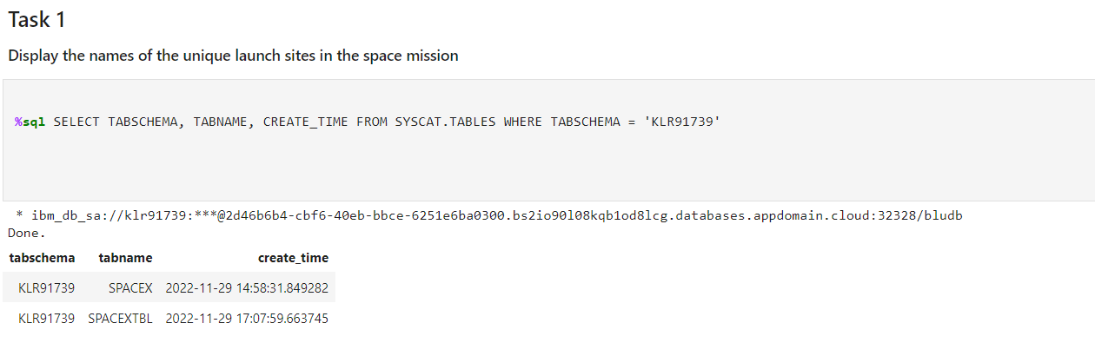
RESULTS for EDA with SQL

Slide 22
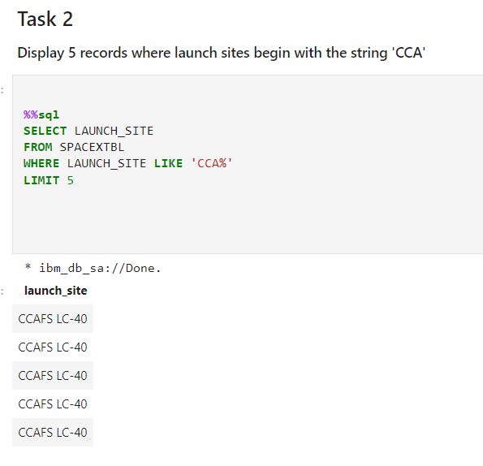
RESULTS for EDA with SQL

Slide 23
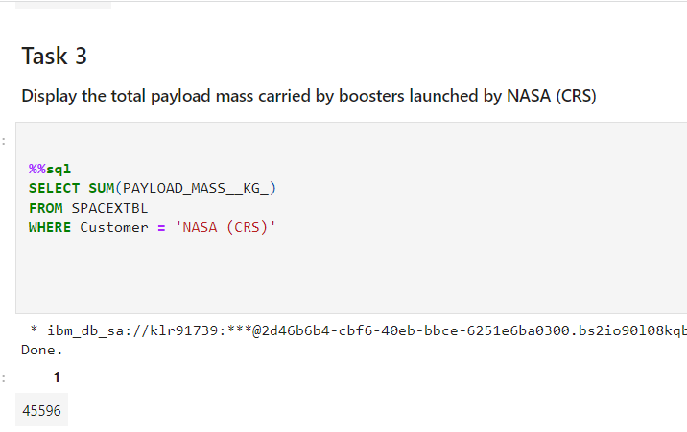
RESULTS for EDA with SQL

Slide 24
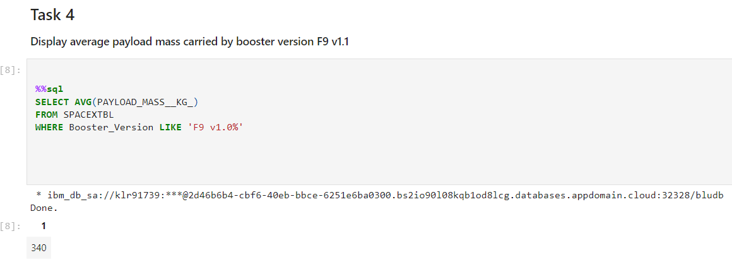
RESULTS for EDA with SQL

Slide 25
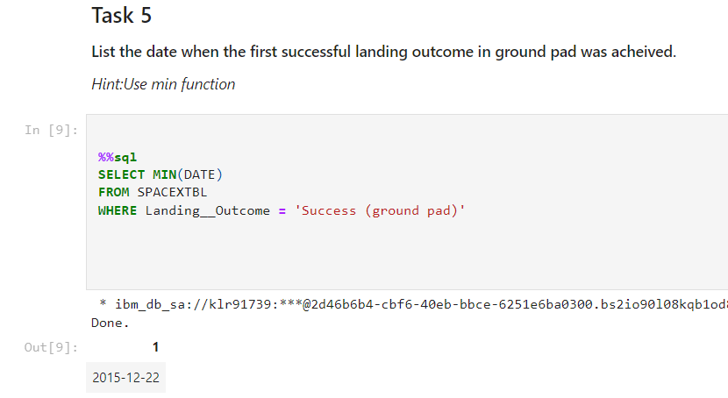
RESULTS for EDA with SQL

Slide 26
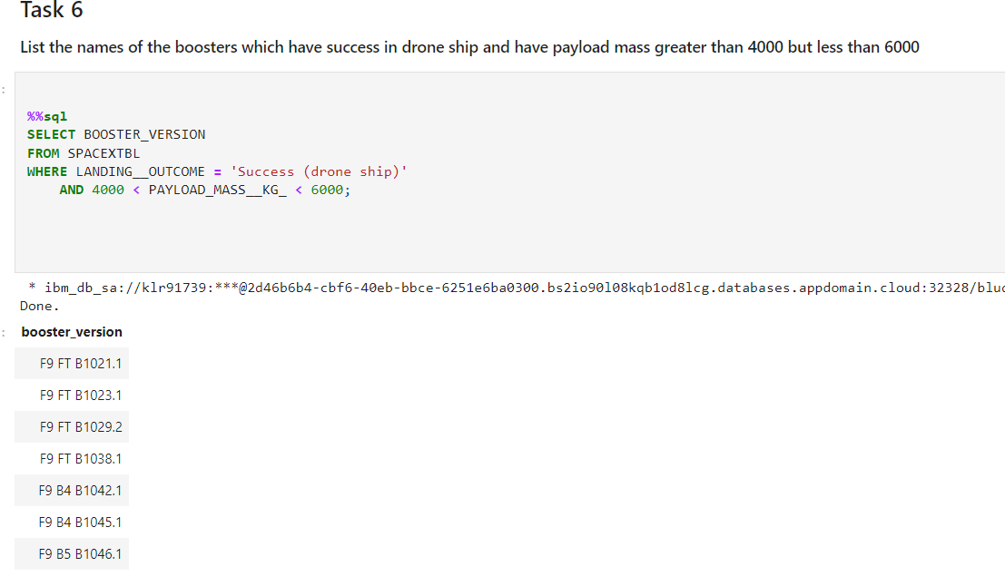
RESULTS for EDA with SQL

Slide 27
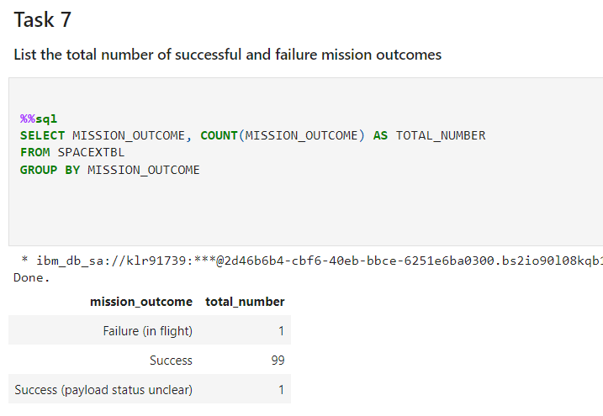
RESULTS for EDA with SQL

Slide 28
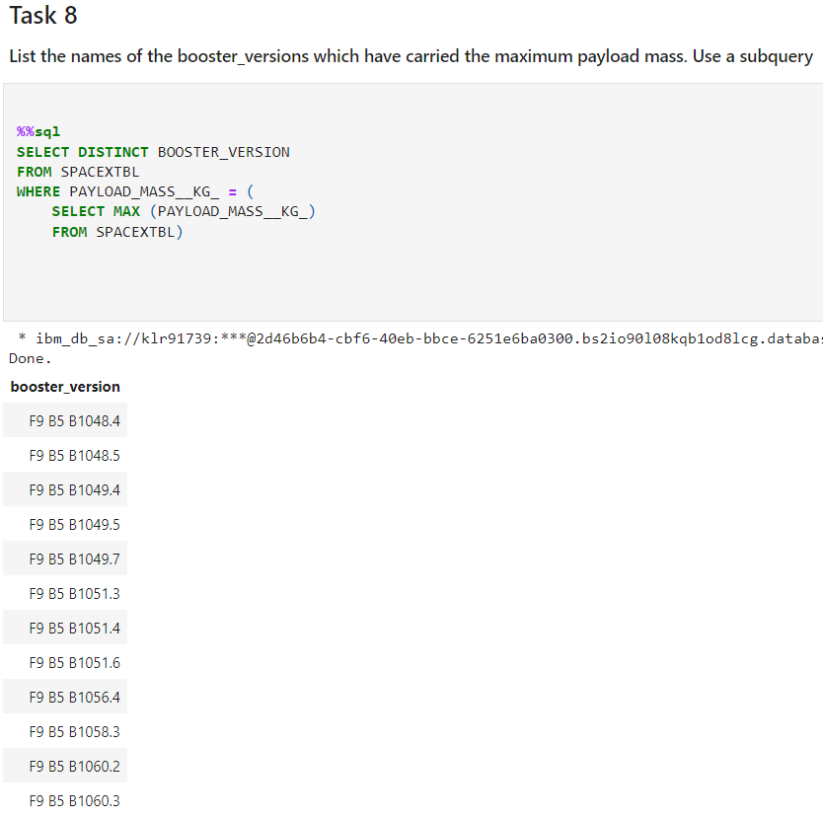
RESULTS for EDA with SQL

Slide 29
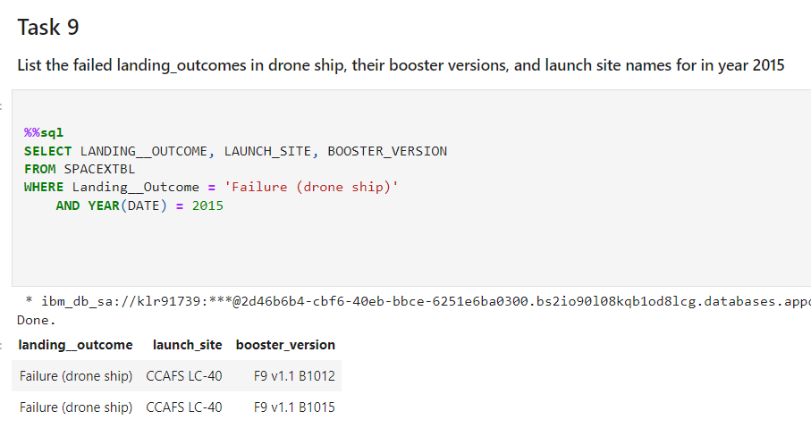
RESULTS for EDA with SQL

Slide 30
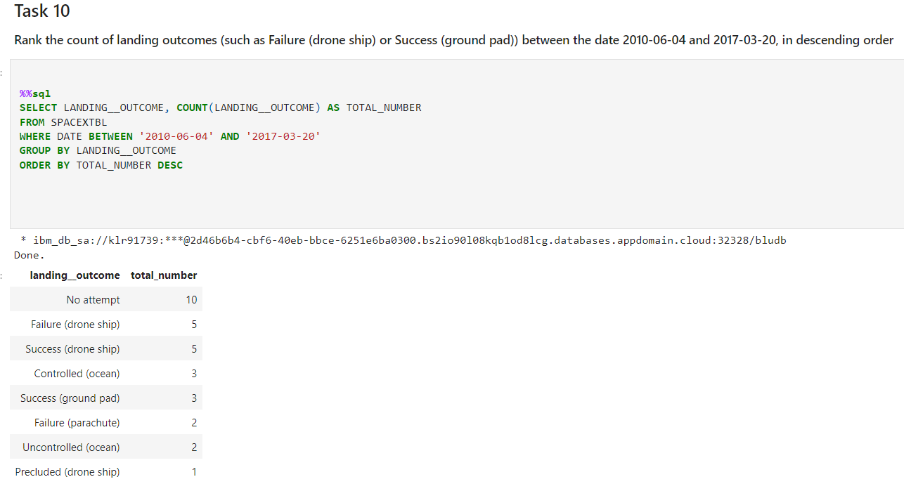
RESULTS for EDA with SQL

Slide 31
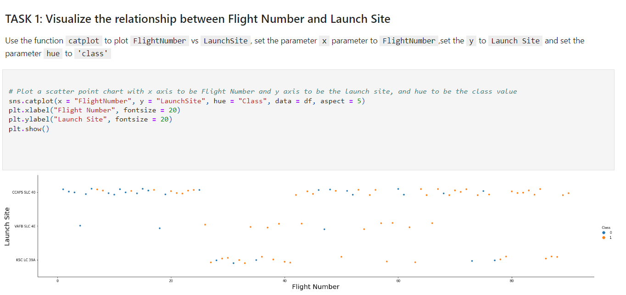
RESULTS for EDA with Data Visualization

Slide 32
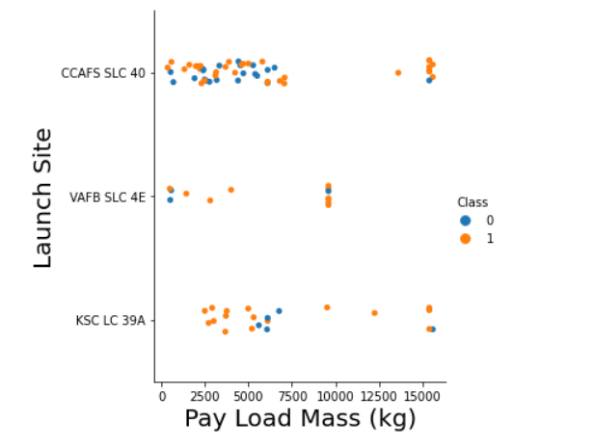
RESULTS for EDA with Data Visualization
We can observe CCAFS SLC 40 Launch Site has
greater Payload Mass with success rate.

Slide 33
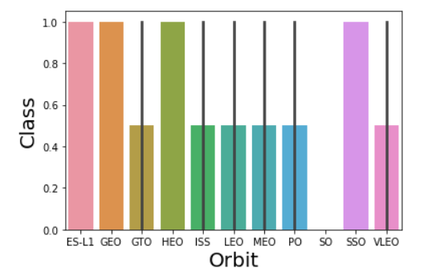
RESULTS for EDA with Data Visualization
We can observe ES-L1, GEO, HEO and SSO orbits have
high success rate than the others.

Slide 34
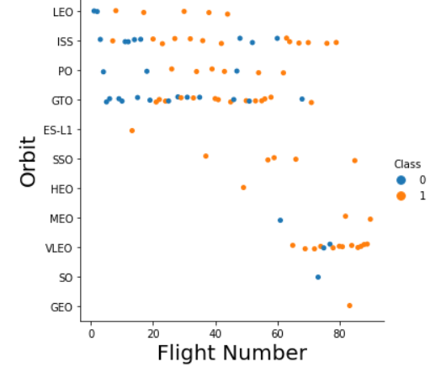
RESULTS for EDA with Data Visualization
We can observe for the LEO orbit success is related with
flight number but we can’t say that for GTO orbit.

Slide 35
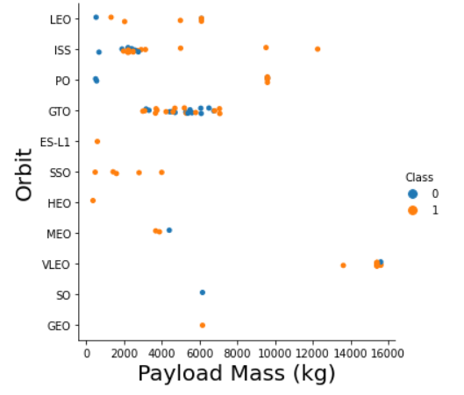
RESULTS for EDA with Data Visualization
We can observe with heavy loads the successful landing
or positive landing rate are more for VLEO, LEO, and ISS.

Slide 36
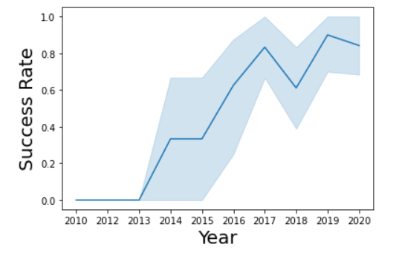
RESULTS for EDA with Data Visualization
We can observe success rate since 2015 kept
increasing almost linearly till 2017.
We can observe there is fluctuation between
some years.

Slide 37
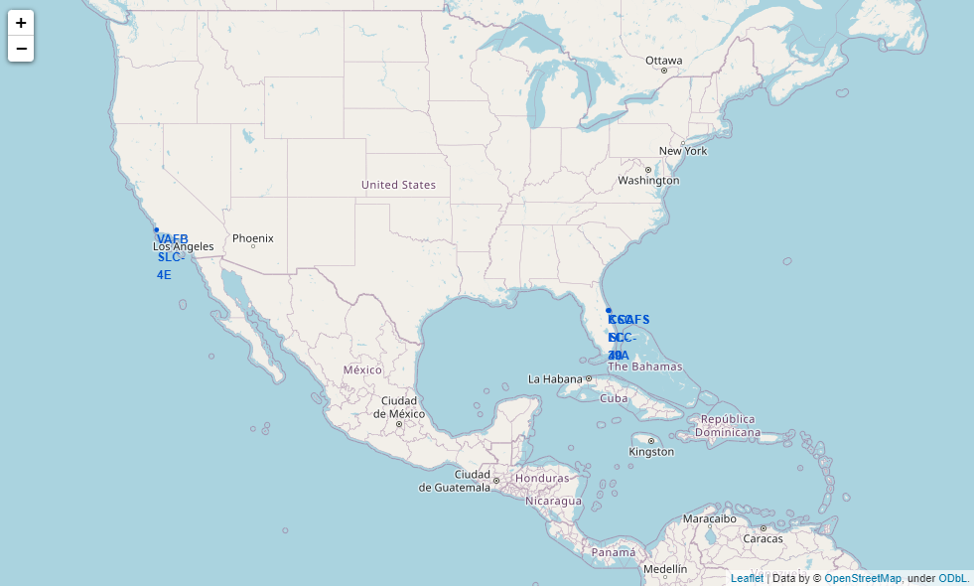
Results for Interactive Analytics with Folium
We can observe that SpaceX launch sites
are in USA’s Coasts. Especially Florida and
California coasts.

Slide 38
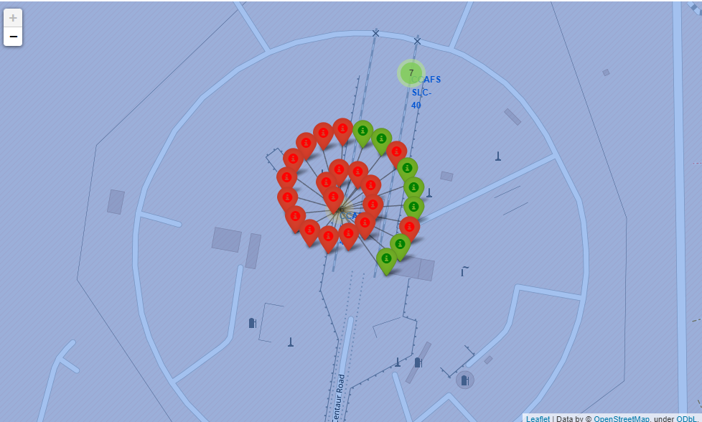
Results for Interactive Analytics with Folium
After, we marked the success/failed launches
for each site on map.
Green markers shows success launches.
Red markers shows failed launches.

Slide 39
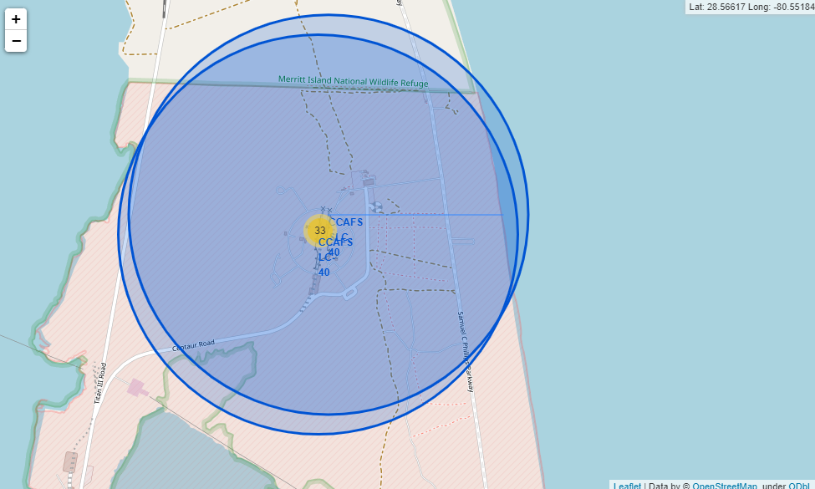
Results for Interactive Analytics with Folium
We calculated the distance between launch
sites to its proximities.
For example, we calculated the distance
between selected launch site to coast.

Slide 40
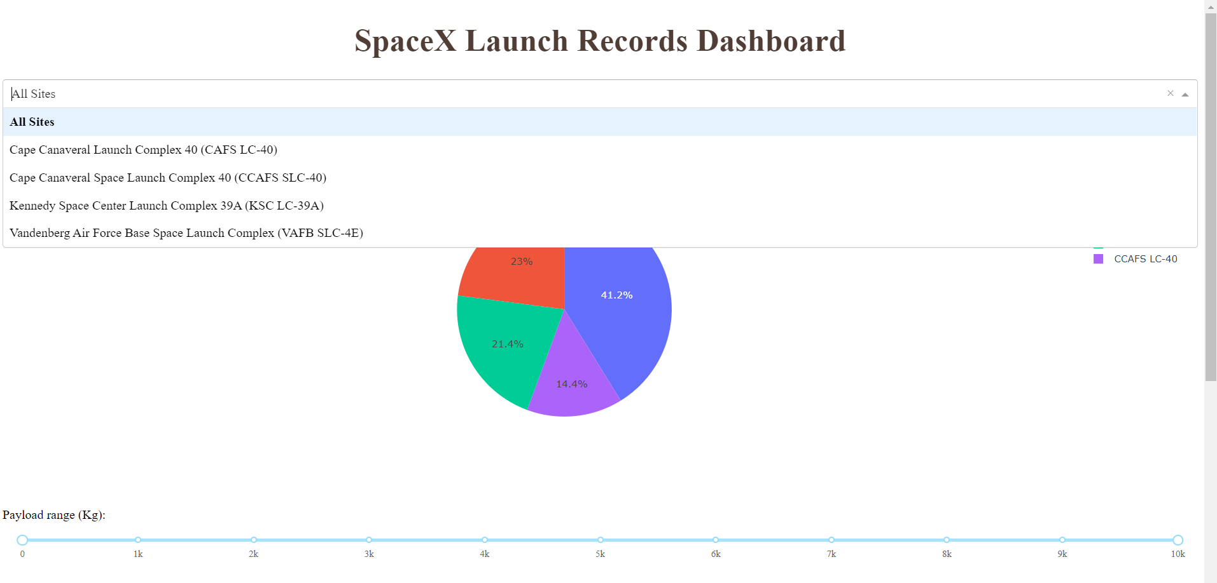
Results for Dashboard with Plotly Dash
We created dashboard with Plotly Dash.
Following pictures shows structure of
dashboard.
Maybe you will search answers for
different questions but these are our findings:
We observed that KSC LC-39A site had
most success rate compare to the others.

Slide 41
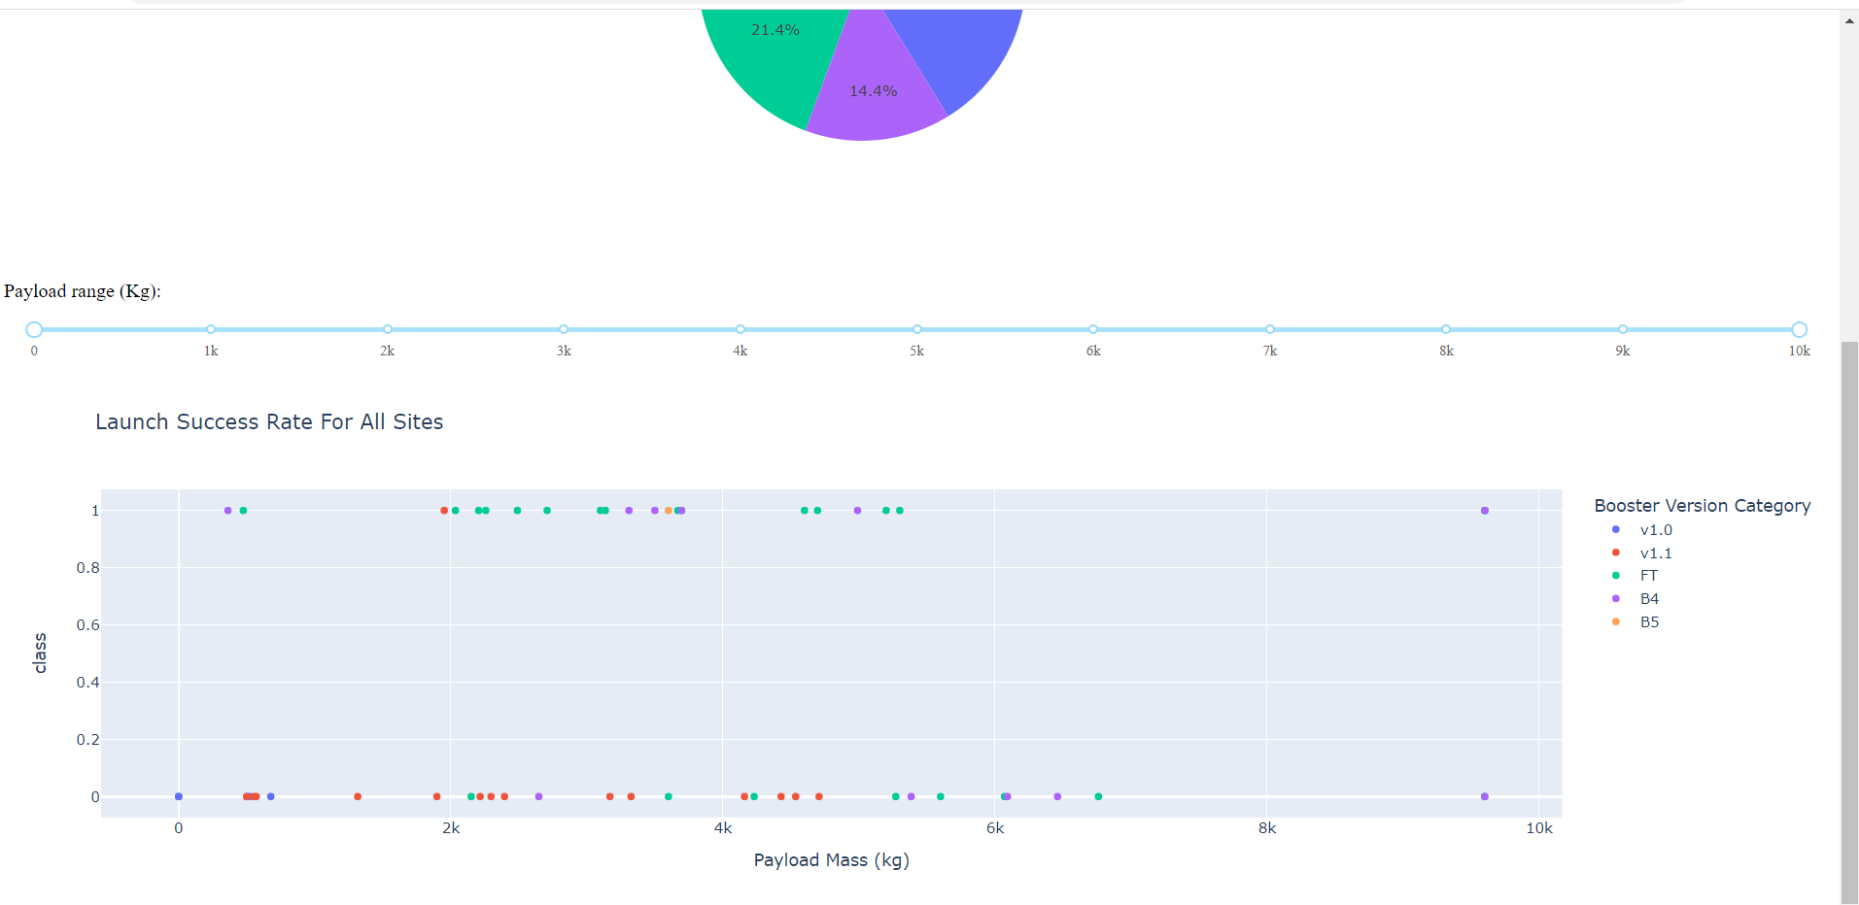
Results for Dashboard with Plotly Dash

Slide 42
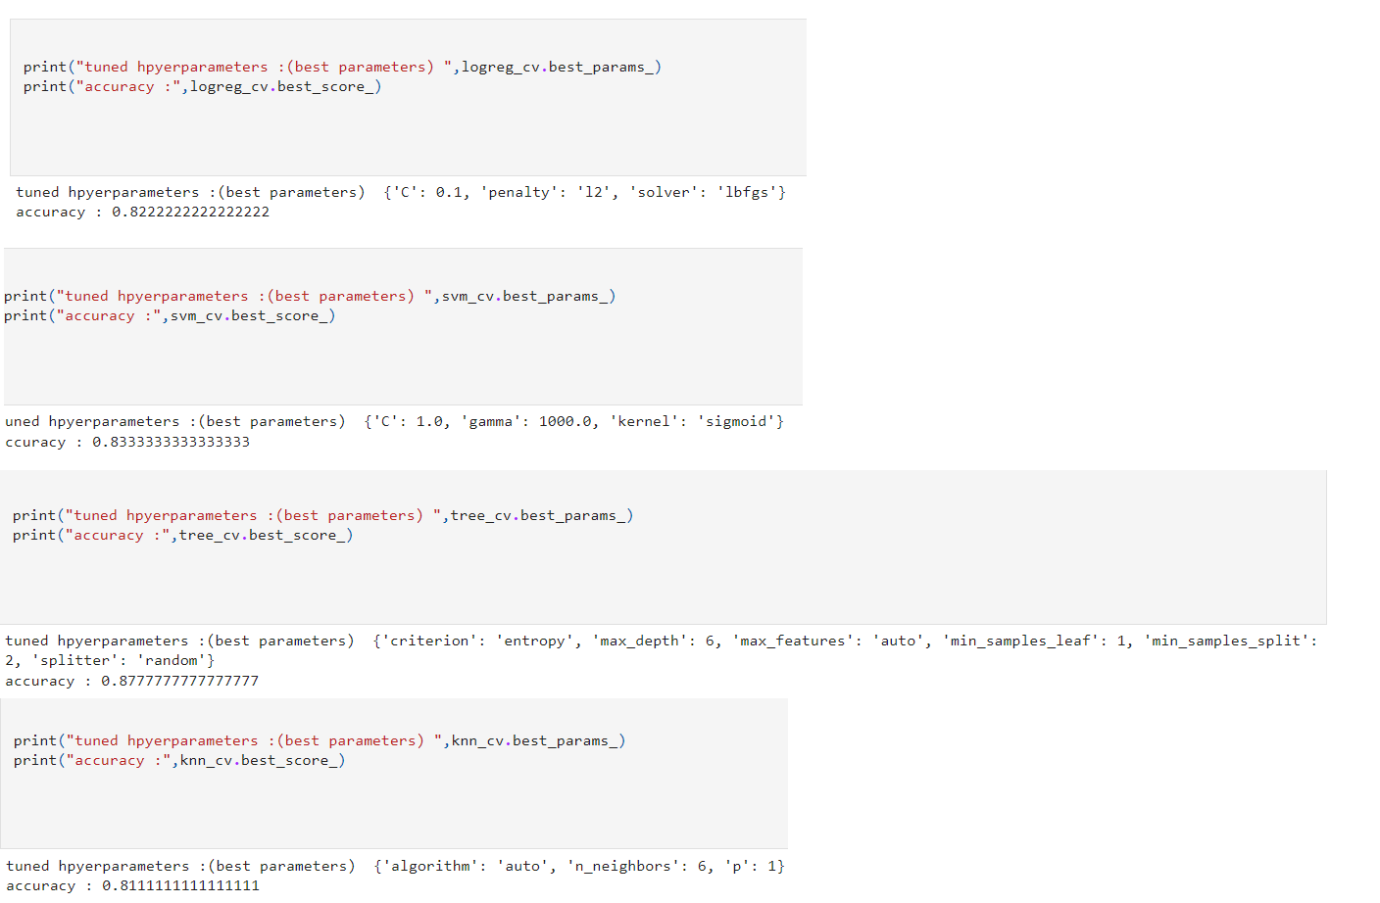
Results for ML Predictions
Best hyperparameters for selected
ML algorithms.

Slide 43
Insights from Machine Learning Predictions

Slide 44
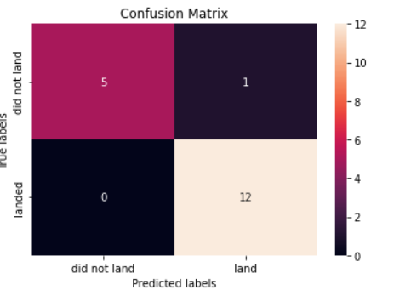
Results for ML Predictions
Logistic Regression confusion matrix.
Examining the confusion matrix, we can
observe that logistic regression can distinguish
between the different classes. We see that the
major problem is false positives.

Slide 45
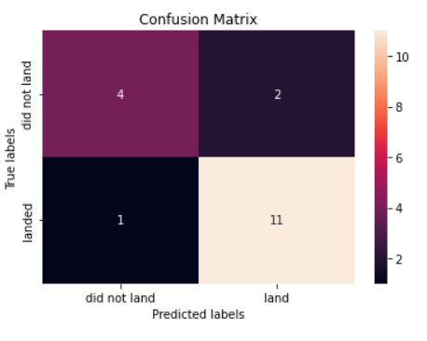
Results for ML Predictions
SVM confusion matrix.
Examining the confusion matrix, we can
observe that logistic regression can distinguish
between the different classes. We see that the
major problem is false positives. Also we see that
the minor problem is false negatives

Slide 46
Results for ML Predictions
Decision Trees confusion matrix.
Examining the confusion matrix, we can
observe that logistic regression can distinguish
between the different classes. We see that the
major problem is false positives.

Slide 47
Results for ML Predictions
KNN confusion matrix.
Examining the confusion matrix, we can
observe that logistic regression can distinguish
between the different classes. We see that the
major problem is false positives.

Slide 48
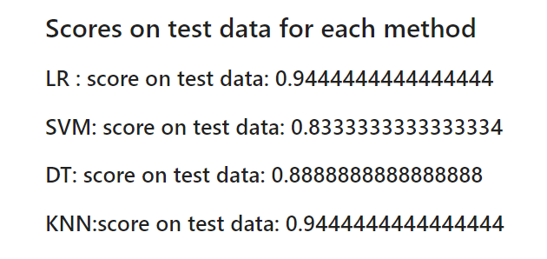
Results for ML Predictions
We can observe that most successful algorithms are:
Logistic Regression
KNN

Slide 49

DISCUSSION
We performed 5 steps at this Data Science Capstone Project.
Data Collection with 2 different methods:
Collection with API
Collection with Web Scraping
Data Wrangling
Data Visualization
Visualization with SQL
Visualization with Graphs
Visualization with Dashboard (Plotly Dash)
Features Engineering
Machine Learning Predictions
Logistic Regression
SVM
Decision Trees
KNN
For further projects we can improve that Project with different ranges of hyperparameters but it needs more
processing time.

Slide 50

CONCLUSION
Launch success rate since 2015 kept increasing almost linearly till 2017.
KSC LC-39A site have most success rate compare to the others.
ES-L1, GEO, HEO and SSO orbits have high success rate than the others
CCAFS SLC 40 Launch Site has greater Payload Mass with success rate.
Logistic Regression and KNN classifiers have best test accuracy.

Slide 51
Thank You
If you want to reach this presantation in pdf format
check out the icon.
In addiction, I want to work and meet my peers.
Reach out to me on Github. Check out the icon.

